Slide 1
Student Job Placement
COSC 3337| Phu Nguyen, Lizthebett Valdivia, Omar Cano, & Chiemela Amaefule

Slide 2
Problem Statement
The data consists of university students’ academic profile and whether they received a full-time position.
This dataset is provided by Dr. Dhimant Ganatara, a professor at Jain University.
We will investigate what factors influence a student to receive a job offer. In other words, what does it take for a student to get a job position?
We will also learn to predict if a student gets placed.
Slide by Omar Cano
Notes:
Omar: This dataset comes from Kaggle, and it is composed of college students’ academic profile and if they got a job post graduation. We will investigate what does it take for a student to get a job. We will also predict if a student gets a job.

Slide 3
Background Info: About the Data
Discrete Values
Numerical Values
gender
ssc_b: The certain Education Board that administers the secondary exam (Central/Others)
hsc_b: The certain Education Board that administers the higher secondary exam (Central/Others)
hsc_s: Area of study in 12th grade
degree_t: undergrad degree title
workex: any work experience
specialisation: mba degree title
status (target): placed (got job) or not placed
ssc_p: raw score of secondary school certificate taken by 10th grade students
hsc_p: raw score of higher secondary school certificate taken by 12th grade students
degree_p: raw score of undergrad degree (think of it like a GPA)
etest_p: raw score of employability test
mba_p: raw score of mba degree (think of it like a GPA)
Slide by Omar Cano
Notes:
Omar: Here are the values of the dataset, they will be covered when we go over their distributions.

Slide 4
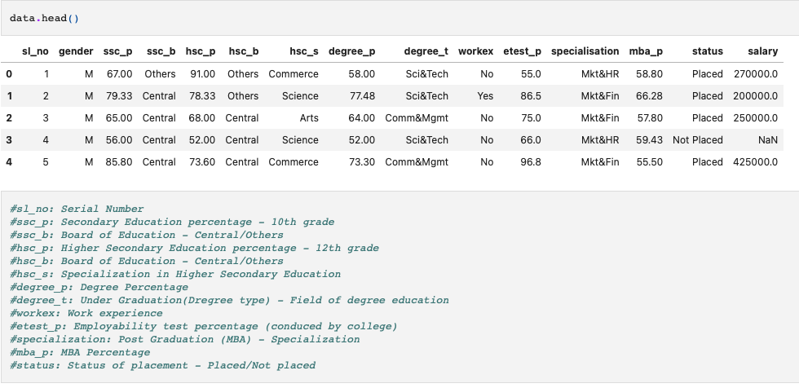
Exploratory Data Analysis

Slide 5
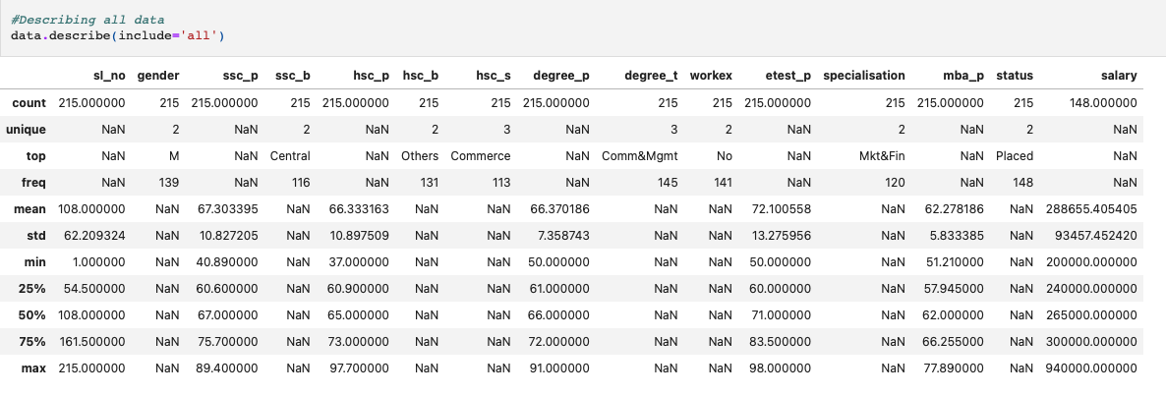
Data Description

Slide 6
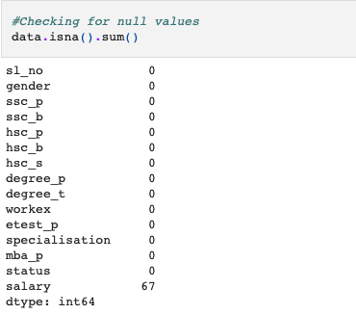
Null Values
There is 67 nulls values for salary because those are the people that are not employ yet
We will further explore the data and find out what factor is most important when getting an internship

Slide 7
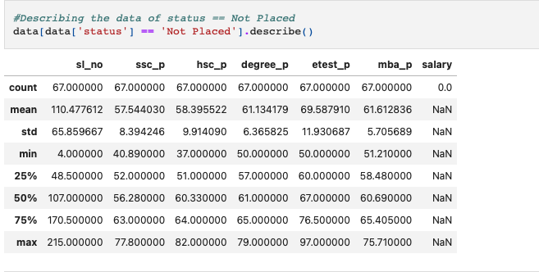
Describe status

Slide 8
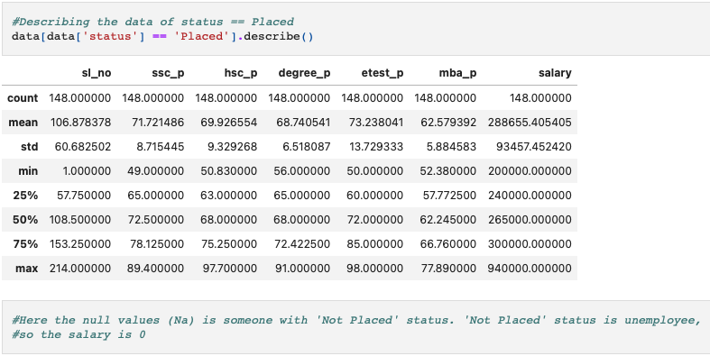

Slide 9
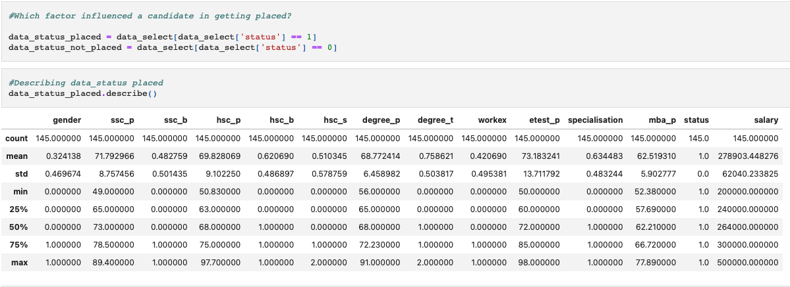
Which factor influenced a candidate in getting placed?

Slide 10
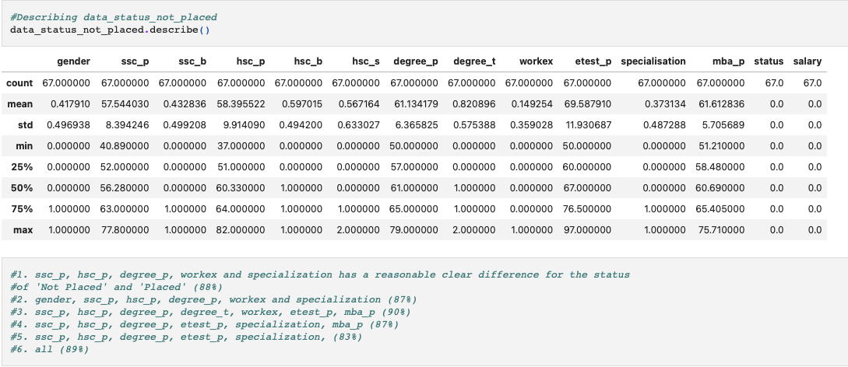

Slide 11
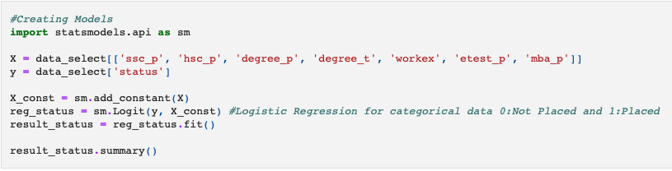
Creating Model

Slide 12
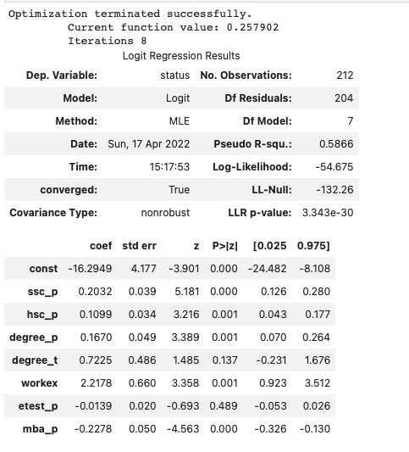

Slide 13
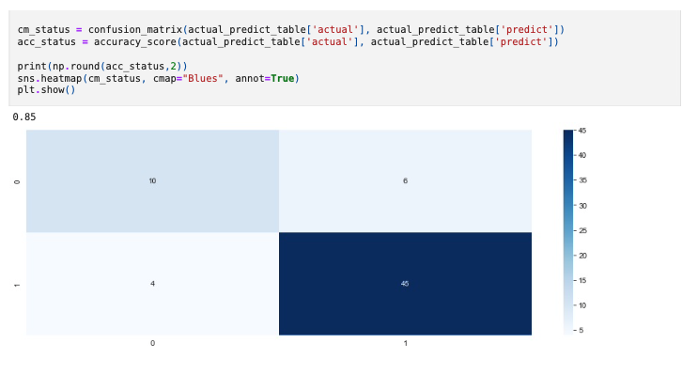
Confusion Matrix

Slide 14
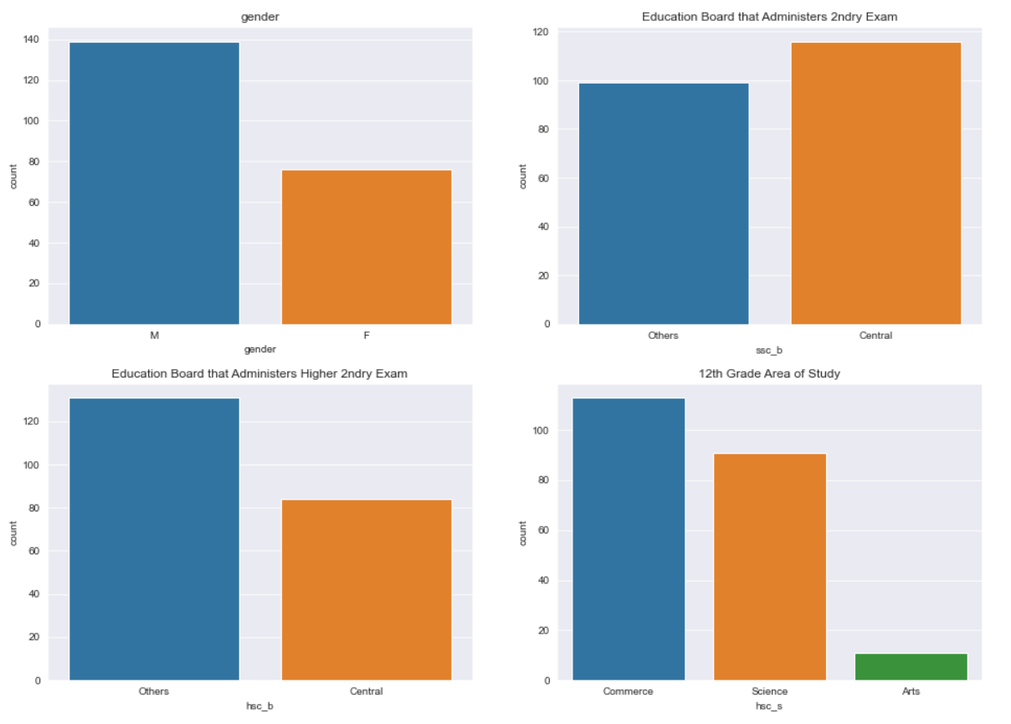
Data Findings
There are more males than females in the dataset.
There is almost the same number of students taking the secondary exam at Central and Others.
There is slightly more students that took the higher secondary exam at Others than Central.
More students centered their focus of 12th Grade study in Commerce than Science and Arts.
Slide by Omar Cano
Notes:
Omar: To attempt to answer our research question (what it takes for student to get placed), I made various countplots to observe any patterns or findings within the discrete values.
M > F
Others = Central (general educational knowledge exams)
Others > Central
Commerce > Science > Arts

Slide 15
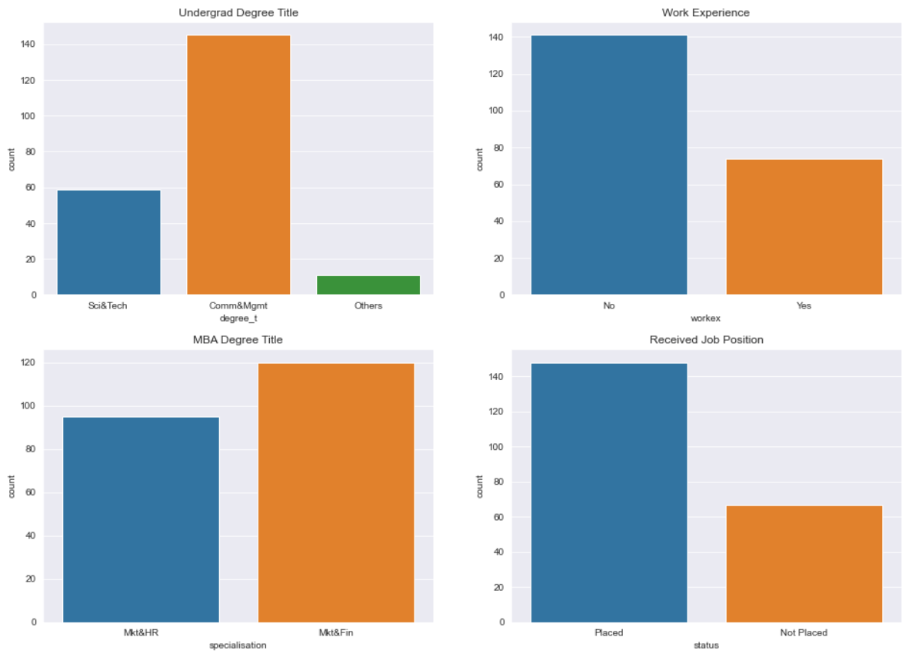
Data Findings
More students centered their focus of undergrad in Comm&Mgmt than Sci&Tech.
More students had no prior work experience.
There is almost the same number of students with MBA degree of either Mkt&HR or Mkt&Fin.
More students received a job position than not.
Slide by Omar Cano
Notes:
Omar: Comm&Mgmt > Sci&Tech
No > Yes
Mkt&Fin > Mkt&HR
Placed > Not Placed

Slide 16
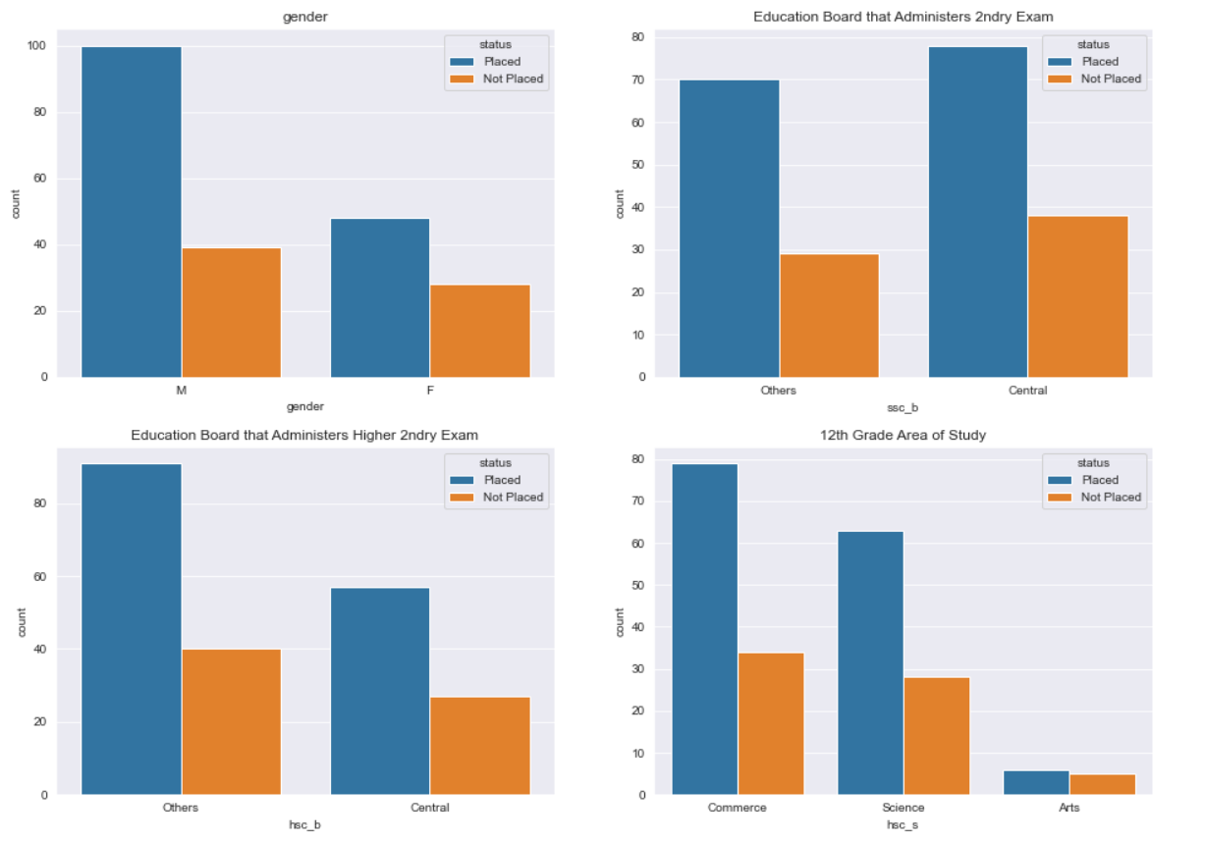
Data Findings
More men get placed than women.
The number of students who took secondary exam under ‘Central’ and got placed is close to the number of those who took it under ‘Other’ and got placed.
More students who took the higher secondary exam under ‘Other’ got placed.
More students who centered their focus of 12th grade study on Commerce got placed. Half of those who studied Arts did not get placed.
Slide by Omar Cano
Notes:
Omar:

Slide 17
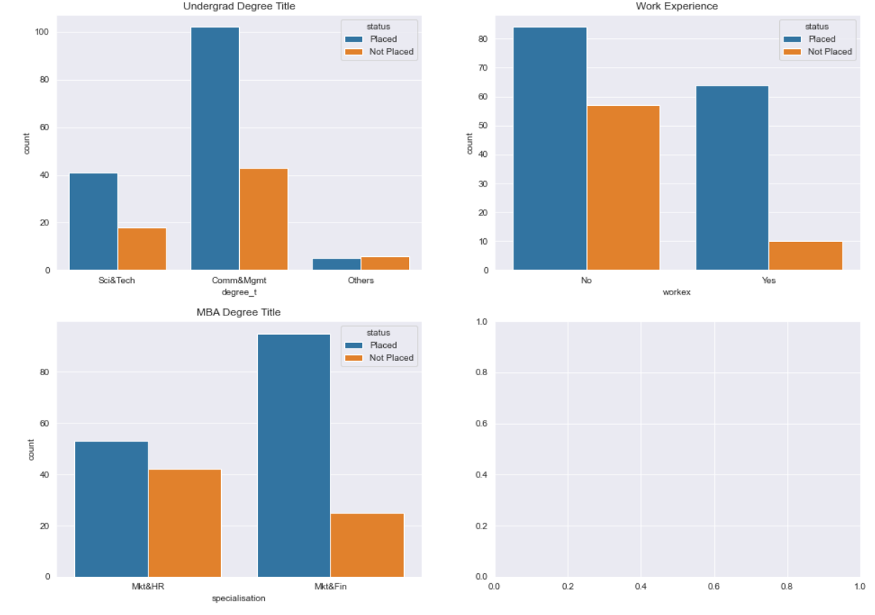
Data Findings
Many who centered their focus of undergrad in Comm&Mgmt got placed, and more than half of those whose undergrad degree is ‘Other’ did not get placed.
More students who did not have work experience got placed. Almost all students who did have prior experience got placed while many who did not have experience did not get placed. Perhaps workex is a good indicator.
More students whose MBA degree is Mkt&Fin got placed, and almost half of those whose MBA is Mkt&HR did not get placed.
In the cases where there is a majority that gets placed, it is likely because those dominate the dataset.
Slide by Omar Cano
Notes:
Omar: Students with no prior experience consists more of the dataset, which explains why more of them got placed.

Slide 18
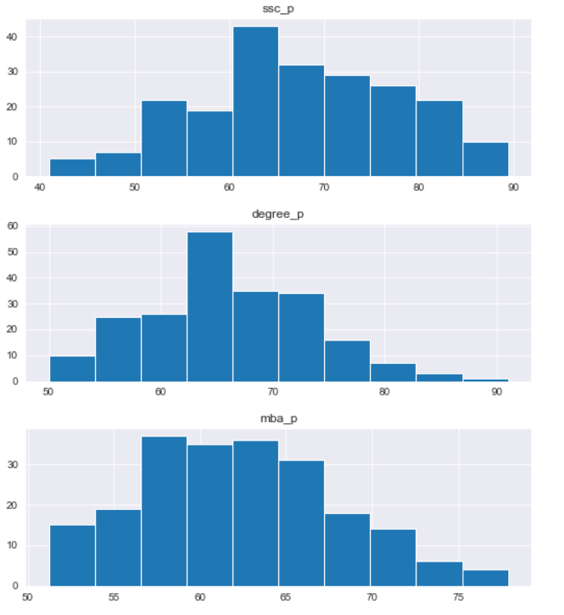
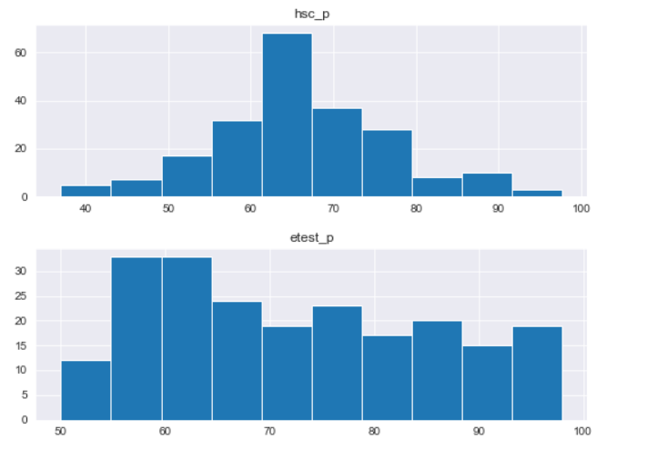
Data Findings
Majority of the students had a grade between 60 and 80 in 10th grade
Most of the students had grades between 60 and 80 in 12th grade
The students had similar grades on their employability tests but there were higher grades around 55 and 65
Most students scored between 57 and 65 on their MBA
Most students scored around 65 in their degree percentage
Slide by Chiemela Amaefule

Slide 19
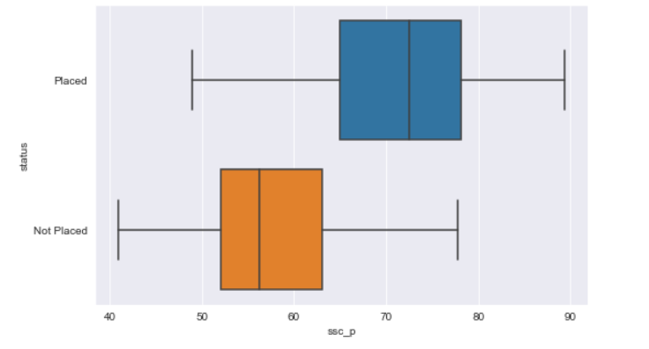
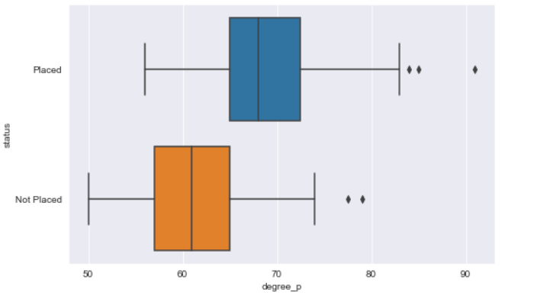
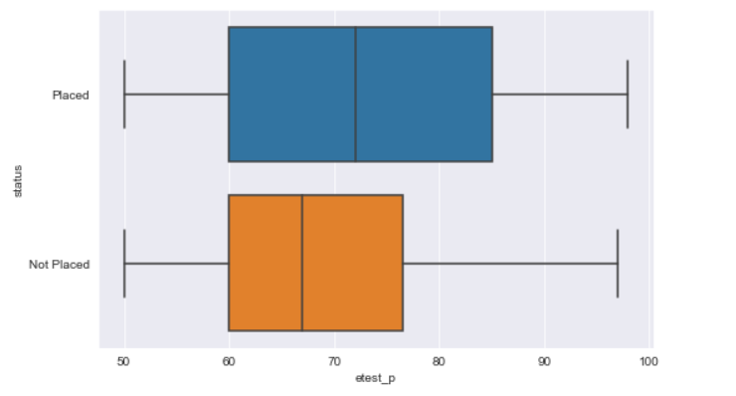
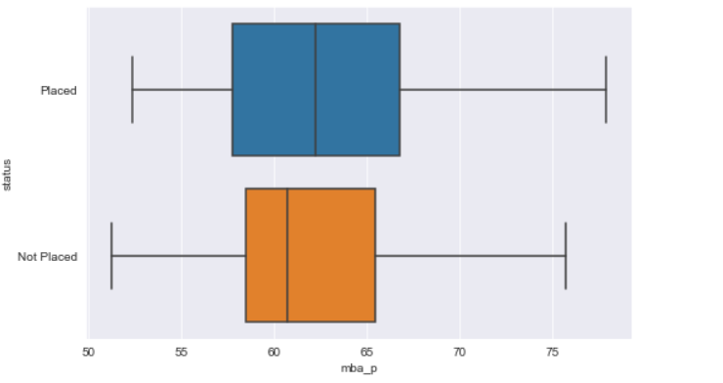
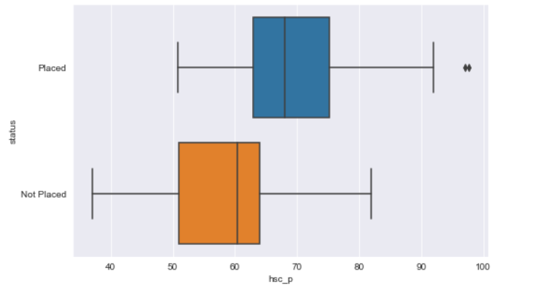
BOX PLOTS
Those placed had higher scores in 10th grade.
Those placed have higher degree scores.
50 % of placed students have an employability test score higher than 72.
50 % of placed students have an MBA percentage higher than 62.
Those placed have higher Higher-Secondary scores.
Slide by Chiemela Amaefule

Slide 20
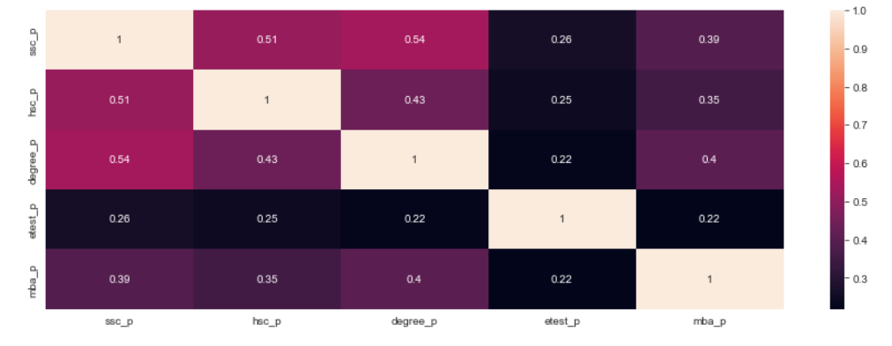
HEATMAP
No multicollinearity exists in our data
Slide by Chiemela Amaefule

Slide 21
Logistic Model + its scores by Phu
-for more info…List location or contact for specification (or other related documents)

Slide 22
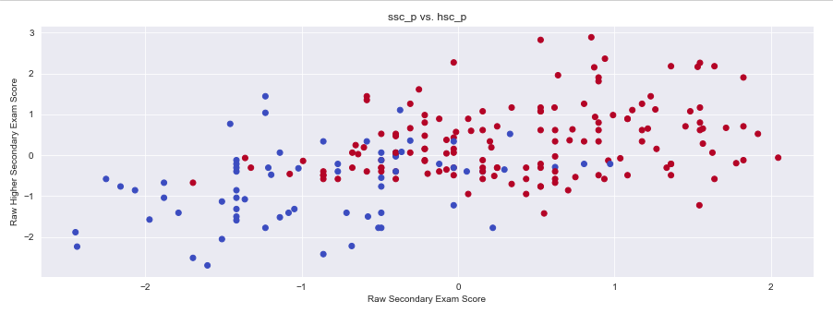
SVM Model

Slide 23
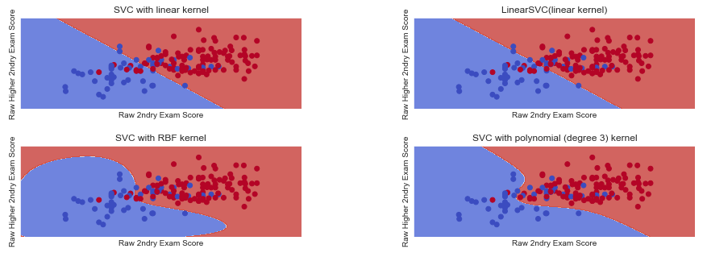

Slide 24
Model Efficiency Comparisons
 | F1 Score | ROC-AUC | Log-Loss
Logistic Model | 0.9 | 0.771 | 5.314
SVM Model | 0.932 | 0.802 | 3.720
All metrics used in this investigation tend to favor the SVM model.
Thus, SVM is more efficient in predicting whether a student gets placed or not.
This is likely because SVM works best with smaller datasets like the one in this investigation.
Slide by Omar Cano

Slide 25
Conclusion: Which Factors Help Students get Placed?
Features like ssc_p, hsc_p, degree_p, and workex influence whether a student will get placed or not.
In other words, the greater the Secondary, Higher Secondary, and Degree score, the more likely a student will get placed.
If a student has prior work experience, then it is very likely that the student will get placed.
Using only the Secondary and Higher Secondary scores in the SVM, we obtain an efficient model that predicts whether a student gets placed or not.
Slide by Omar Cano

